Slide 1
Week 5 Lecture
Algorithms and Data Structures
      Dr Mehmet Bülent Özcan,
      (Module Leader/Lecturer/Tutor)
        Room: Cantor 9418
        Phone: extn 6900
        Email: m.b.ozcan@shu.ac.uk

Slide 2
Learning Objectives
To understand the deques data structure

Slide 3
Contents of the Lecture
Deques
Why Do We Need Deque Data Structures in the Real World?
Representation of Deques in Memory
An Example
Complications

Slide 4
Deques
A deque is a linear list in which elements can be added or removed at either end but not in the middle. The term deque is a contraction of the name double-ended queue.
There are two variations of a deque- namely, an input-restricted deque and output-restricted deque, which are intermediate between a deque and queue.
Specifically, an input-restricted deque is a deque which allows insertions at only one end of the list but allows deletions at both end of the list;
an output-restricted deque which allows deletions at only one end of the list but allows insertions at both end of the list.

Slide 5
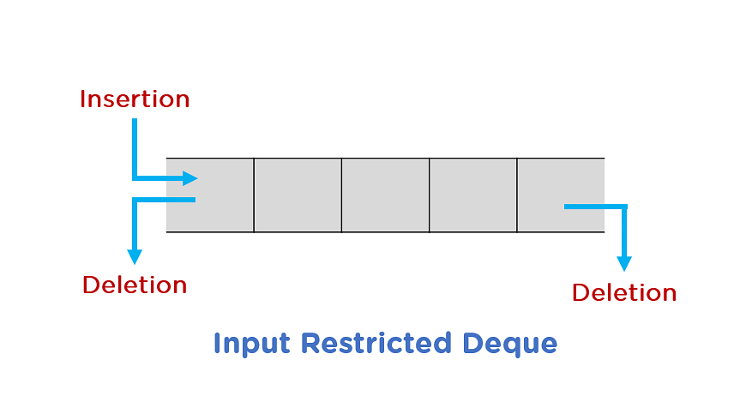

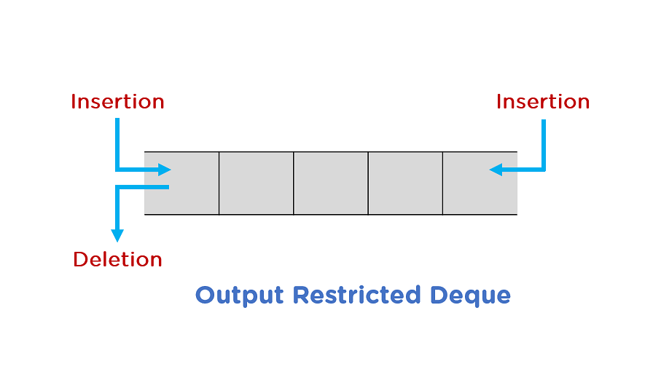

Deques(2)

Slide 6
Why Do We Need Deque Data Structures?
In queueing systems to manage the order of incoming requests. Requests can be added to the front or back of the queue depending on their priority or arrival time.
In a web browser's history. Recently visited URLs are added to the front of the deque, and the URL at the back of the deque is removed after some specified number of insertions at the front.
Storing a software application's list of undo operations.
In task management systems to manage the order and priority of incoming tasks. Tasks can be added to the front or back of the deque depending on their priority or deadline.

Slide 7
Deques (3)
CLASS Deque
STATES
full, empty /* full means a full stack, etc. */
REPRESENTATION
declare QUEUE[0..max-1], front, rear, item
OPERATIONS
procedure create()
procedure insertFront(IN item)
procedure insertBack(IN item)
procedure removeFront(OUT item)
procedure removeBack(OUT item)
function getFront()
function getBack()

Slide 8
Representation of Deques
There are various ways of representing a deque in a computer.
Let’s consider a circular queue representation in which a circular array DEQUE with pointers LEFT and RIGHT, which point to the two ends of the deque.
We assume that the elements extend from the left end to the right end in the array.
The term “circular “ comes from the fact that we assume that DEQUE[1] comes after DEQUE[n] in the array.

Slide 9
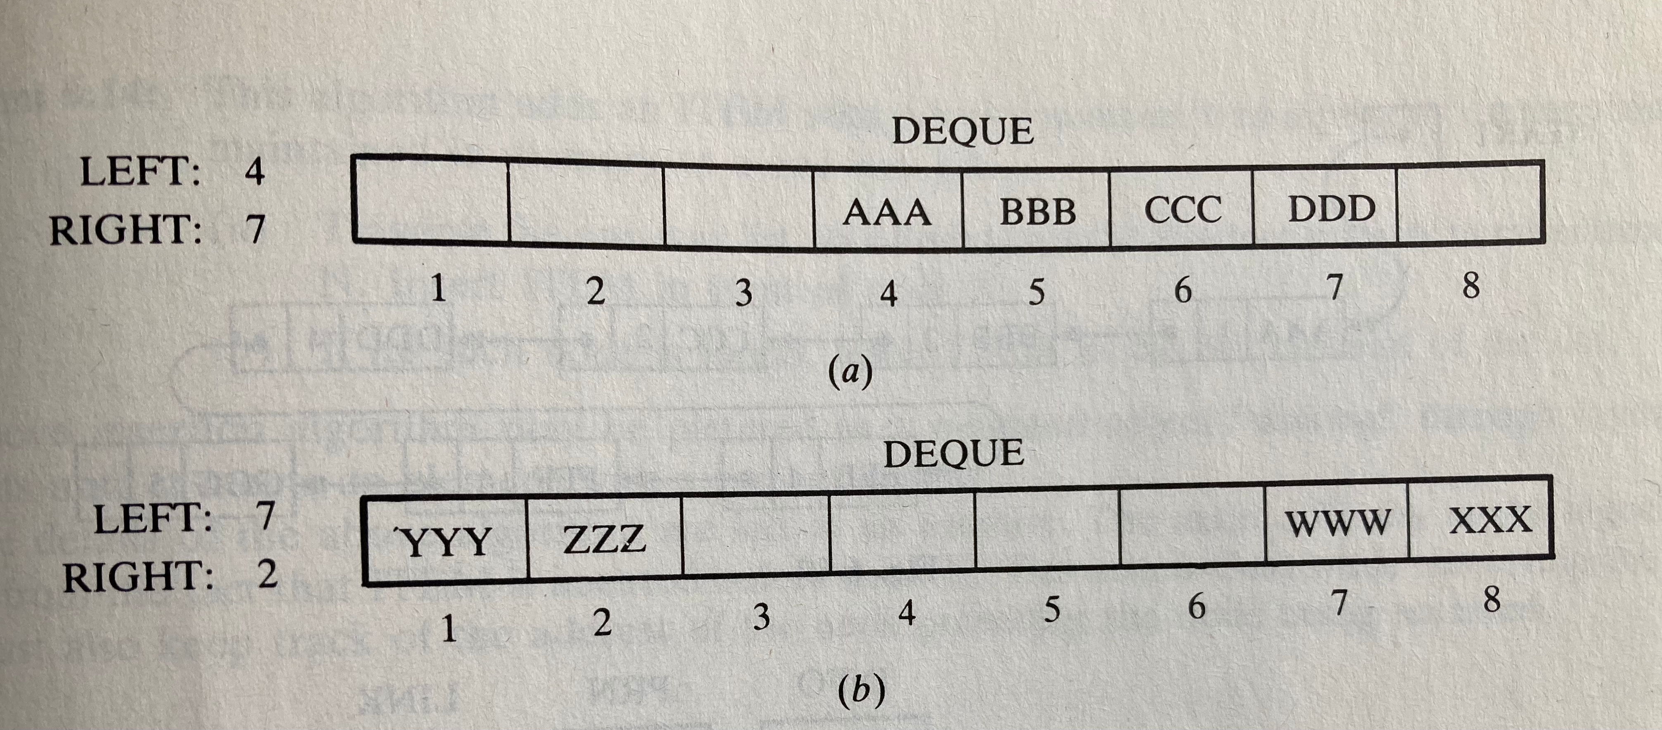
An Example
Consider the two deques below, each with 4 elements maintained in an array with N = 8 memory locations. The condition LEFT = NULL will be used to indicate that a deque is empty.

Slide 10
Complications
As with standard queues, a complication may arise
  when there is overflow, that is, when an element is to be inserted into a deque which is already full, or
  When there is underflow, that is, when an element is to be deleted from a deque which is empty.

